Slide 1
Brooklyn Housing Predictions
Pavani Reddy Podduturi
A20545675

Slide 2
Introduction
What’s this About?
1

Slide 3
“Insert inspirational New York City quote because no one thinks of Brooklyn first; and because this quote slide was too pretty to delete from the theme, so we’re keeping it!”
Notes:
Starting the presentation off on a nice, light and hearty note.

Slide 4
What’s this About?
Introduction to Brooklyn's Housing Market:
Notable for its dynamic nature and significance within the larger New York City real estate landscape.
Subject to influences from demographic shifts, economic trends, and urban development projects.
Research Objective:
Unravel the complex web of variables that have shaped housing prices in Brooklyn through rigorous data analysis and interpretation.

Slide 5
Goal
What’s the objective?
2

Slide 6
What are we trying to do?
Brooklyn’s housing effect in the NYC metropolitan area.
Enhance the ability to predict housing prices in brooklyn.
Analyze variables impacts on market fluctuations
Visualize these results using graphs, plots, etc.
Acknowledge the potential for this goal to evolve in the future.
Notes:
Goal: The ultimate goal of this research is to get a better understanding of how a major borough’s residential market ties in with the larger metropolitan statistical area’s story. Being able to apply a model on an existing set of real-time data and understanding how each variable affects the fluctuations in the market will help us delve deeper into getting a better understanding of how to predict future prices and ultimately understand why Brooklyn is the way it is and how that affects New York City’s housing market as a whole. Now, as the project continues; and based on further findings, the goal may deviate from the initial path in order to accommodate any supplemental information.

Slide 7
Methodology
What’s the plan?
3

Slide 8
What’s the Plan?
Objective:
Apply linear regression to analyze the housing market from 2016-2020 (Pre-Covid).
Data Segmentation:
Divide each year into quarters (Q1-Q4) for detailed analysis.
Explore quarterly changes to understand socio-economic impacts.
Data Handling:
Perform data split for training and validation.
Allocate a major portion for linear regression model training.
Notes:
Objective:
We aim to understand the housing market dynamics from 2016-2020 using linear regression.
The goal is to pinpoint influential variables and track their changes over this pre-Covid period.
Data Segmentation:
Breaking down each year into quarters (Q1-Q4) allows us to delve into specific quarterly trends.
This segmentation aids in discerning if changes are correlated with socio-economic developments.
Data Handling:
The dataset will be split for training the linear regression model and validating its predictions.
A substantial portion is allocated for model training, ensuring robust analysis and prediction capabilities.

Slide 9
The Plan - Part 2
Data Processing:
Implement data cleaning techniques.
Exclude unnecessary columns by verifying formats and removing anomalies.
Feature Engineering:
Conduct feature engineering using linear regression model.
Enhance the model's predictive capabilities for housing market analysis.
Visualization:
Utilize graphs, boxplots, histograms, etc., for visual representation.
Illustrate patterns and trends to enhance data interpretation.
Notes:
Data Processing:
We'll employ effective data cleaning techniques to enhance the quality of our dataset.
Columns deemed unnecessary will be excluded after ensuring data consistency and accuracy.
Feature Engineering:
Feature engineering using linear regression improves the model's ability to predict housing market trends.
This step enhances the model's predictive power, contributing to a more nuanced analysis.
Visualization:
Graphical tools like graphs, boxplots, and histograms will visually represent complex patterns.
These visual aids offer a clearer understanding of the trends and variations in the data.

Slide 10
TIMELINE - YEARS IN FOCUS
First year of focus for this project. A lot of economic growth about to kickstart in the area.
Nets, still terrible. Continued growth. Fresh influx of companies, students and money.
2016
2018
2017
2019-20
Continued economic growth, slow changes in the real estate sector, perhaps because the nets are terrible.
Coronavirus happened. Didn’t need to add another point in the timeline for an extra year. At least the nets caught a break.

Slide 11
OUR PROCESS IS EASY, LITERALLY
Analyse & Process
Train & Validate
Visualize & Conclude
Simple. We go through the data and get a good sense of it. Then, we change it to our requirements.
Apply multiple models to see which one best aids our progress in this project. Then, select that model.
Visualize results using graphs, plots, etc just so it is easier for everybody to understand.

Slide 12
Data Analysis
4

Slide 13
Data Analysis
Dataset Preparation (2016-2020):
Meticulous preprocessing of Brooklyn housing data.
Removal of redundancies and alignment with project objectives.
Enhanced interpretability through column name revisions.
Data Refinement:
Elimination of null values and optimization of data types.
Conversion of string values to numeric types.
Removal of commas for numerical consistency.
Notes:
Dataset Preparation:
We started by thoroughly examining the Brooklyn housing dataset from 2016 to 2020. This involved meticulous preprocessing to ensure the dataset's coherence and reliability.
Data Refinement:
The initial steps included removing redundant columns and revising column names to align with our project objectives. We also focused on data quality by eliminating null values and optimizing data types. This involved converting string values to numeric types and ensuring numerical consistency by removing commas.

Slide 14
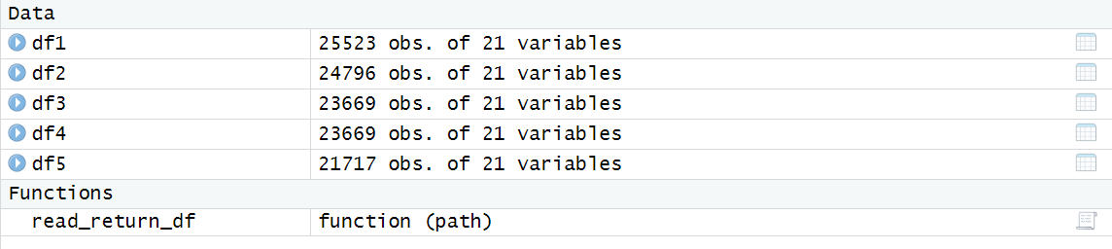
Dataframes with observations and features
Notes:
Here,
df1 is the dataframe of the year 2016 with 25523 observations and 21 features
df2 is the dataframe of the year 2017 with 24796 observations and 21 features
df3 is the dataframe of the year 2018 with 23669 observations and 21 features
df4 is the dataframe of the year 2019 with 25523 observations and 21 features
df5 is the dataframe of the year 2020 with 21717 observations and 21 features

Slide 15
Data Analysis
Temporal Analysis:
Restructuring dates using the date class.
Quarter-wise segmentation for detailed trend exploration.
Consolidation and Outcome:
Integration of data frames for a comprehensive dataset.
Reveals insights into five-year housing trends in Brooklyn.
Notes:
Temporal Analysis:
A key aspect of our analysis was the enrichment of the temporal dimension. We used the date class to restructure dates, and to gain a more detailed understanding, we segmented the dates into quarters. This nuanced approach allows us to explore trends with a heightened level of sophistication, focusing on subtleties like seasonality patterns and year-over-year variations.
Consolidation and Outcome:
We then integrated the individual data frames into a consolidated dataset. This new dataset forms the bedrock of our analysis, providing a comprehensive view of housing trends over the designated five-year period. The outcome is a valuable insight into the dynamic landscape of property acquisition and nuanced fluctuations in property values, significantly enhancing our understanding of the housing sector in Brooklyn.

Slide 16
Data Processing
What do we need?
5

Slide 17
Data Processing:
Steps involved in the data processing:
Data Collection
Data Cleaning
Feature engineering
Data Transformation
Model Training [Subsequent Section]
Model Evaluation [Subsequent Section]

Slide 18
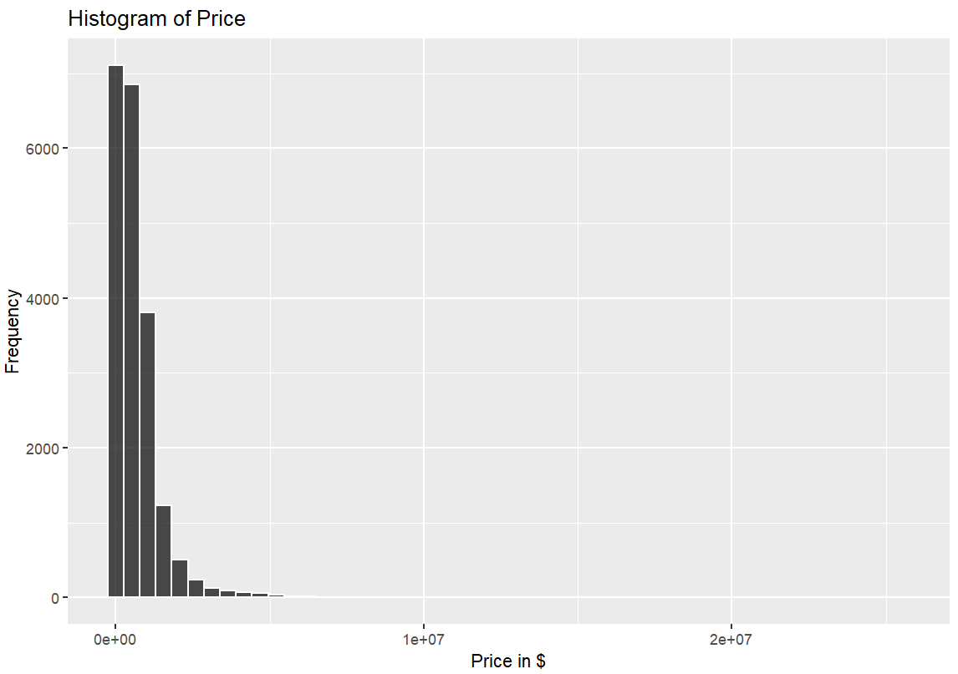
Histogram on Price vs Frequency

Slide 19
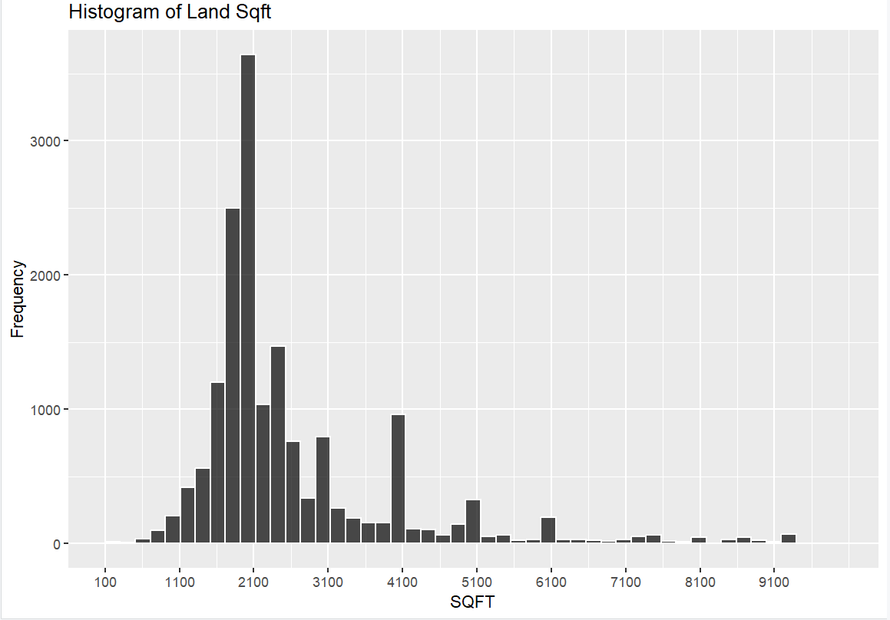
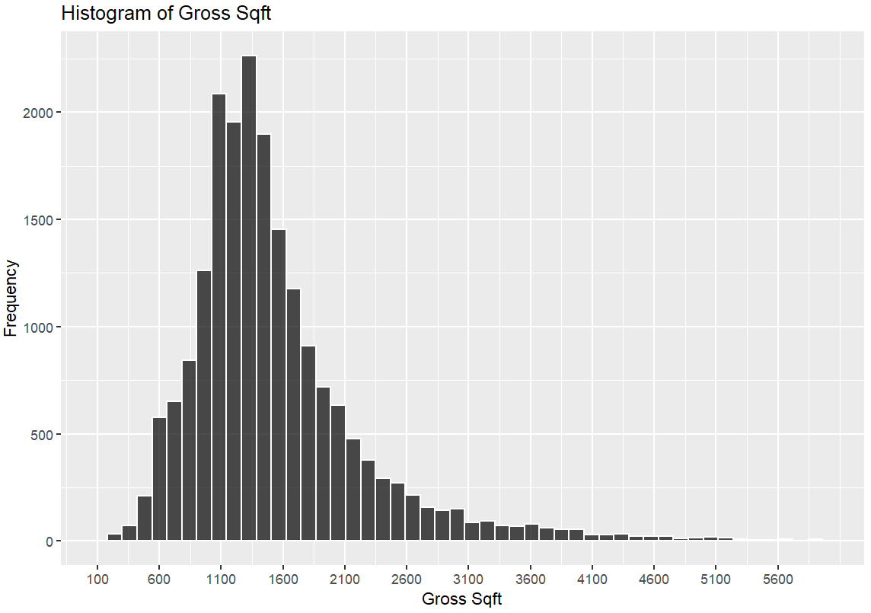
Histogram on Sqft vs Frequency
Histogram on Gross Sqft vs Frequency

Slide 20
119,374
Number of observations in the resultant data frame that we did not test on because that was before final processing. Although, big numbers are cool to look at.

Slide 21
119,374
20,185
100%
Observations before final processing.
Observations after final processing based on constraints.
Tested on those 20 grand!

Slide 22
Model Training
How do we get what we want?
6

Slide 23
Model Training
Data Analysis and Preprocessing:
Completed data analysis and preprocessing phase.
Linear regression model is utilized.
Model Training and Comparison:
Employment of four different models for training.
A thorough comparison of models.

Slide 24
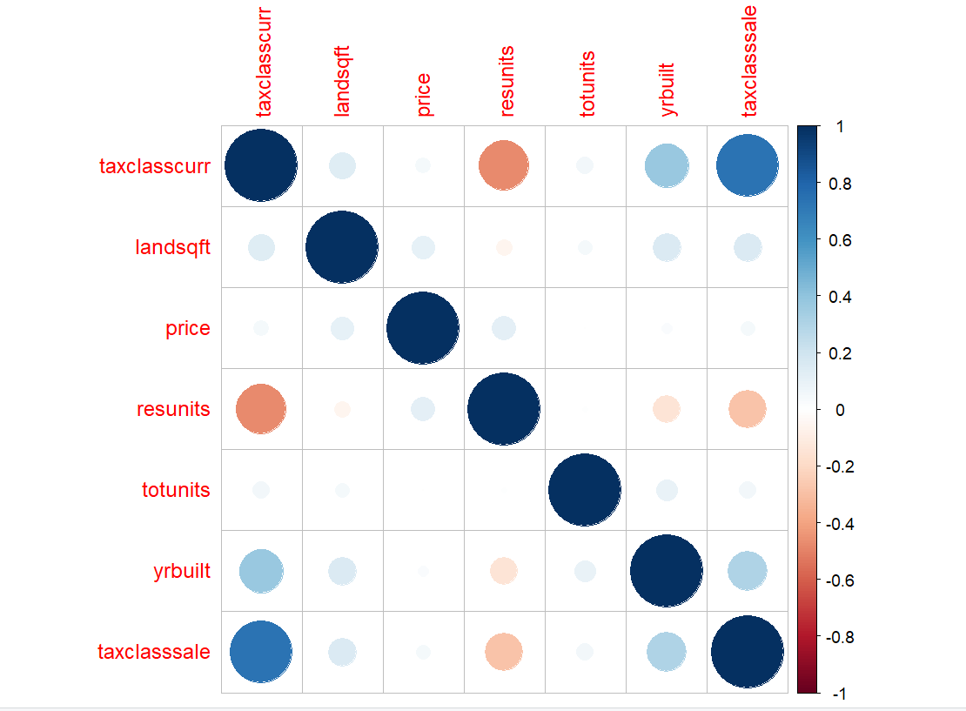
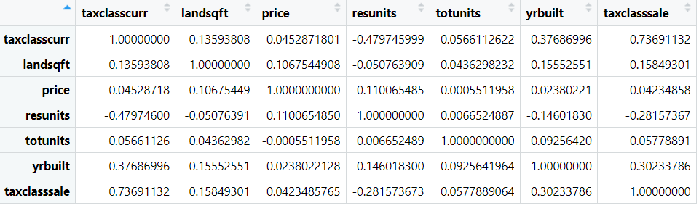
Correlation of features:

Slide 25
Model Training
Evaluation Metrics:
Evaluation of models using R-Squared, RMSE values,and degrees of freedom.
Considering multiple metrics for comprehensive assessment.
Model Selection and Decision:
The model that best suited project objectives is chosen among 4 models.
Decision based on performance in terms of R-Squared, RMSE, and model complexity.

Slide 26
Model Validation
Which one’s the best?
7

Slide 27
Model Validation
Model validation is a crucial step in assessing the performance and generalization capability of a predictive model, such as one used for Brooklyn housing pricing prediction.
By rigorously validating the model, you ensure that it provides reliable predictions on new, unseen data, enhancing its utility in making accurate housing price predictions in Brooklyn.

Slide 28
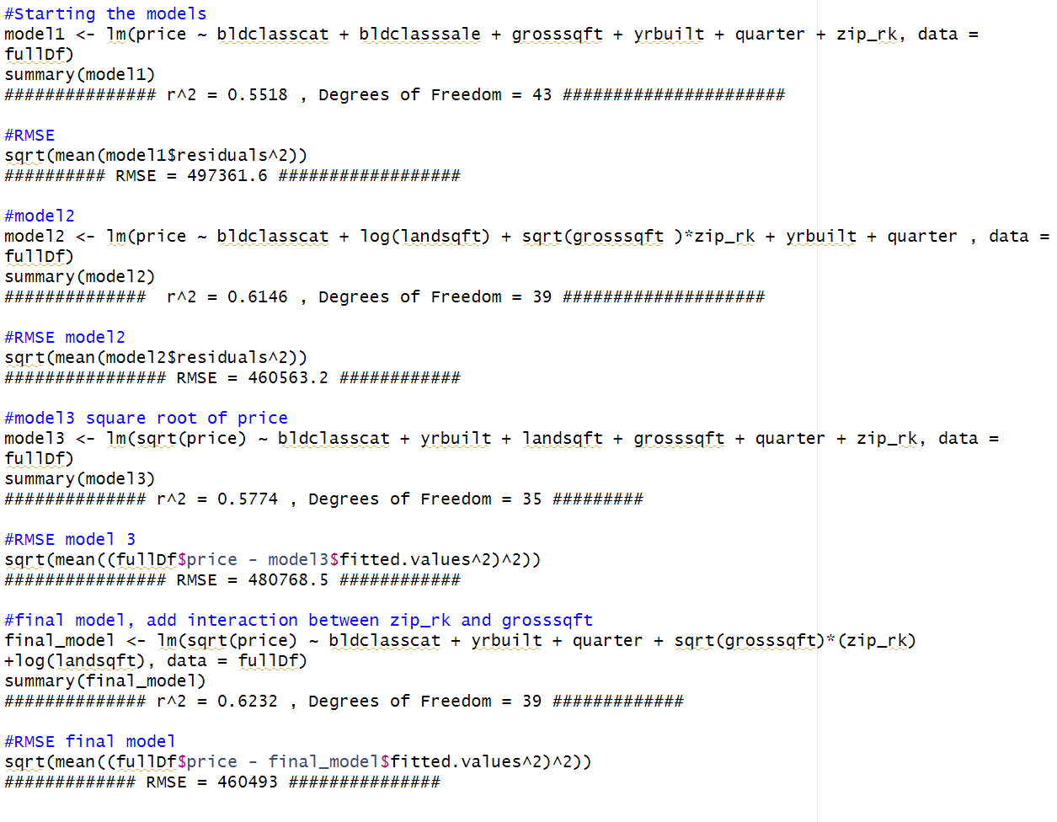
This is how the Models were tested by Linear Regression:

Slide 29
Model Selection and Validation
We chose to go with the final model we trained because of:
Subtle differences in R-Squared, RMSE values and Degrees of Freedom.
Felt this model was best suited for our progress.

Slide 30
Conclusion
What does it conclude?
8

Slide 31
CONCLUSION
Objective: Analyzing Brooklyn housing prices from 2016 to 2020 using linear regression.
Impact : Informing legislators, investors, and urban planners for sustainable development.
Contribution: Enriching urban economics discussions with insights into future price trends.
Prediction: Applying a robust model for interpreting factors influencing market movements.
Narrative : Dissecting Brooklyn's history to offer a dynamic perspective for decision-makers in the evolving real estate landscape.

Slide 32
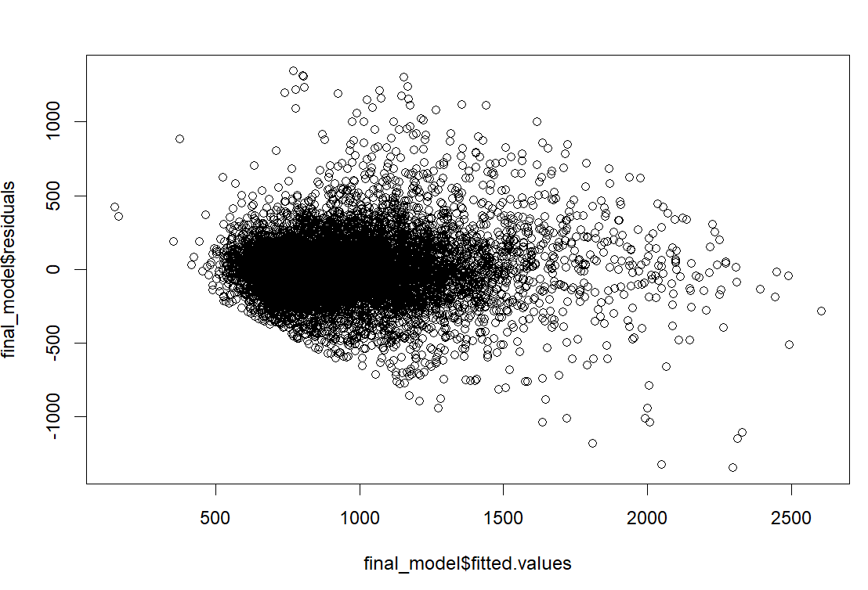
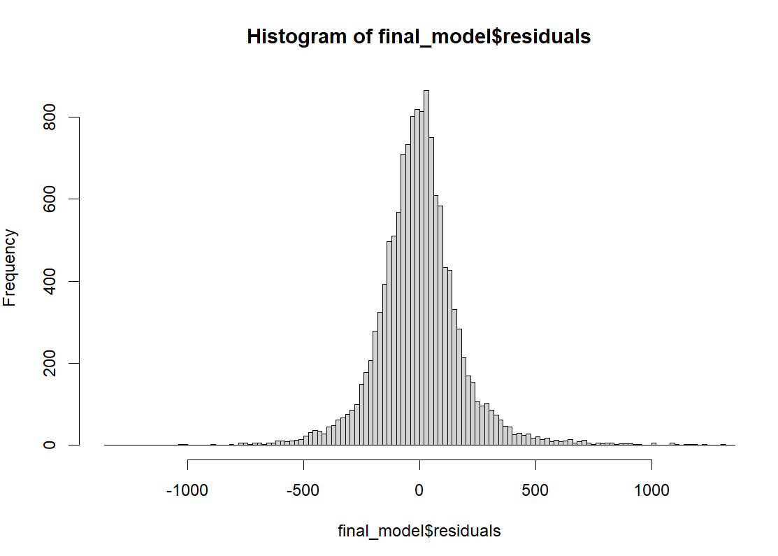
Final Model Residuals vs Fitted Values
Histogram of Final Model Residuals

Slide 33

THANKS!

